Slide 1

ACCESSING GOVERNMENT SERVICES FOR PwD

Slide 2

The Rights of Persons with Disabilities Act, 2016 is an Indian law that ensures equal rights and opportunities for people with disabilities (PWD).
The Act promotes the full inclusion of persons with disabilities in society by ensuring accessibility, non-discrimination, and equal opportunities across various sectors.

Slide 3


KEY PROVISIONS
Access to Education and Employment: PWD have the right to inclusive education and equal opportunities in employment.
Healthcare and Social Services: The act mandates access to healthcare, social security, and other essential services.

Slide 4

3. Accessible Infrastructure: Government buildings and public spaces must be made accessible to people with disabilities.
4. Rights Protection: It also protects against discrimination and ensures participation in public life.

Slide 5

The Indian government provides a range of services for PWD, including disability certificates, financial assistance, educational support, and vocational training. Many of these services can be accessed online to increase convenience and accessibility.

Slide 6

Department of Empowerment of Persons with Disabilities (DEPwD)
The DEPwD is part of the Ministry of Social Justice and Empowerment and works to support PWD in India through various schemes and programs.

Slide 7
Disability Certificate Application: PWD can apply online for a disability certificate through the DEPwD portal. This certificate is essential for accessing government services and benefits, such as financial aid, healthcare support, and reservation in education and employment.
Schemes for Skill Development and Employment: DEPwD provides several schemes for the vocational training and employment of PWD, such as the National Handicapped Finance and Development Corporation (NHFDC), which offers financial assistance for self-employment and small businesses.
Accessible Infrastructure: The government promotes accessible infrastructure, including ramps, tactile paths, and signages for PWD in public places and transport systems.

Slide 8
ONLINE ACCESS
PWD in India can access these services by visiting the DEPwD website (https://disabilityaffairs.gov.in), where they can apply for certificates, view government schemes, and find information about assistive technologies and other support services.
Accessibility Features: The DEPwD website is designed with accessibility in mind and is compatible with screen readers and other assistive technologies. The portal also supports different Indian languages.

Slide 9
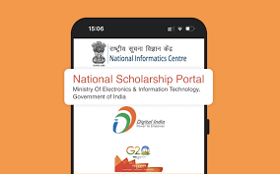
Online Benefits and Schemes:
Scholarships and Education Support:
The government of India offers scholarships and financial aid to PWD to support their education at various levels, from primary education to higher education. PWD can apply for these scholarships through online portals like the National Scholarship Portal (NSP).

Slide 10

Disability Pension and Financial Aid:
Various state and central government schemes offer disability pensions or financial aid to low-income families with a member who has a disability. These benefits can often be applied for online, making it easier for PWD to access financial support.

Slide 11
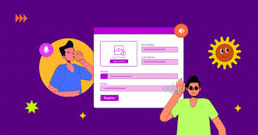
Accessible Forms and Websites:
The government ensures that the application forms for these services are available in accessible formats, including screen reader-compatible PDFs, and some portals also support voice commands or text-to-speech features.

Slide 12
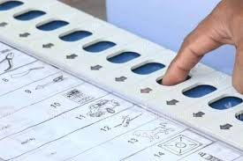

Other Key Government Programs:
Accessible Voting:
The Election Commission of India has made efforts to ensure that polling stations and election materials are accessible to PWD. In addition, PWD can register to vote online and request postal ballots if needed

